Slide 1
Remove Duplicates Benchmark Analysis
Alfredo Pomales III
Victor Lugo
David Riquelme

Slide 2
Project Motivation
The decision to choose the Remove Duplicates Benchmark began with homework 3. The performance was more dependent on the system(architecture) the benchmark was running on. The team found that evaluating different operating systems and hardware limitations on performance would be an interesting topic. As one of the topics for the final project was benchmark performance we chose that. The decision to choose Remove Duplicates was based on the previous experience of the team with the algorithm.

Slide 3
Implementation
The benchmarks were run for different inputs on three different machines. Utilizing the PBBS benchmark repository, we ran the algorithm observing its performance. The algorithm was also run using both a deterministic hash(gives same hash values for entries) and a serial hash(can give different hash values for same entries). Using the hash values which are calculated by auxiliary data, the elements with multiple of the same hash values are considered.

Slide 4
Experimental Setting
Input Sizes
1K
10K
100K
1M
5M
10M
50M
100M
250M
500M
Machines Utilized
Mac OS X High Sierra
CentOS
Ubuntu 16.04
Machine Specification
2.2 GHz Intel Core i7 and 16 GB 1600 MHz DDR3 RAM
2 CPUs, 48 threads, 134956859392 RAM, 3.10GHz Intel Xeon, 3 caches: 32KB, 256KB, 30MB
291 Nodes

Slide 5
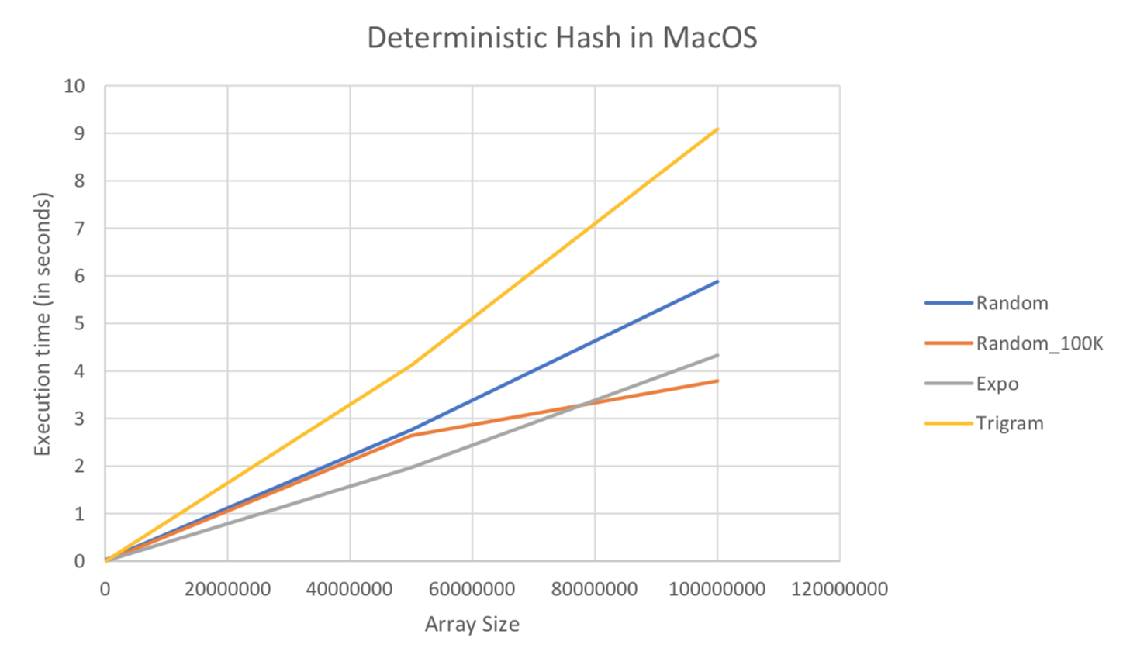
Results

Slide 6
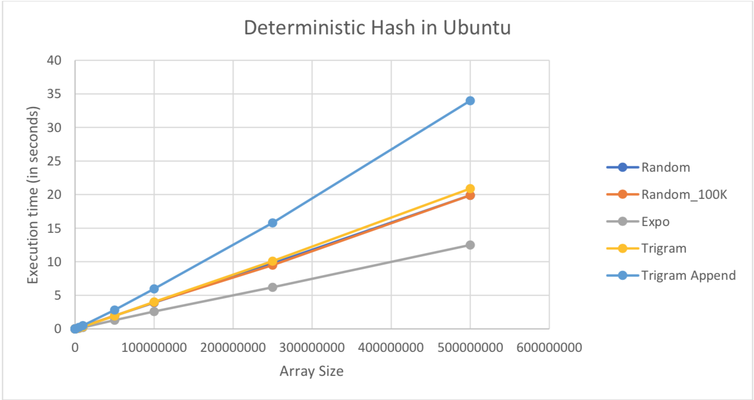
Results

Slide 7
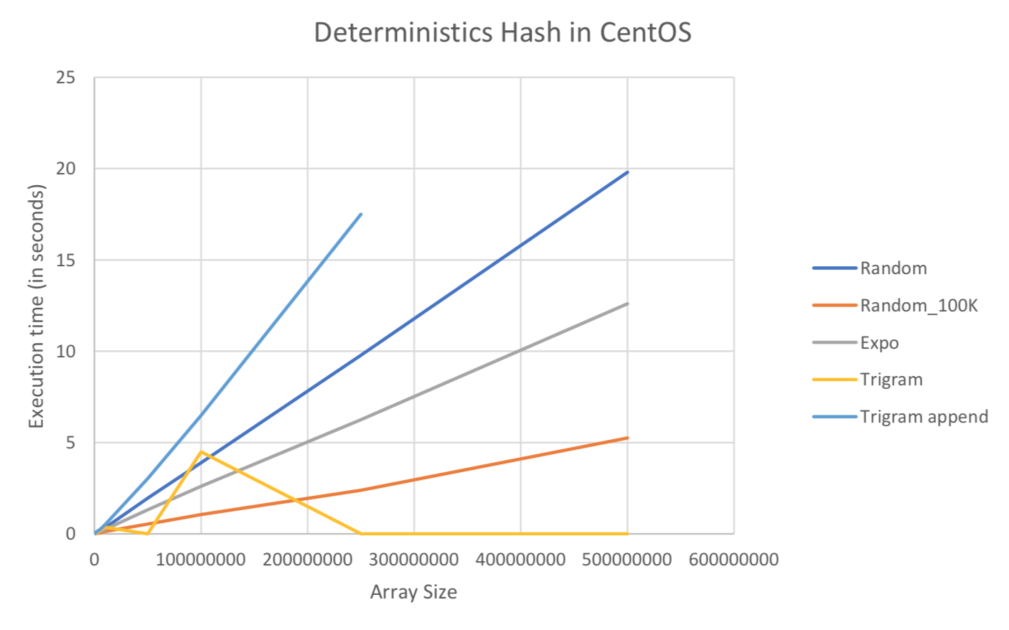
Results

Slide 8
Conclusions
The values did not vary greatly between the different hashing methods, but did vary between the different operating systems, confirming our hypothesis that architecture is more important than implementation. However for future works different parallel frameworks (cilk++, mpi, CUDA) could be used to more efficiently measure the distinctions different implementations could have on the runtime of such benchmarks.

